Slide 1
Advocating for
Your Child with Dyslexia
© HIDA 2022

Slide 2
HIDA’s Mission is to increase awareness
of dyslexia in our community; provide support
for people with dyslexia, their families and
educators; promote teacher training; and,
improve literacy for struggling readers.

Slide 3
KATHY FERGUSON, PH.D
Professor, University of Hawai‘i Mānoa
Author, A Resource Guide About Dyslexia for People in Hawai‘i
Certified Orton-Gillingham Private Tutor
Past HIDA Board Member

Slide 4
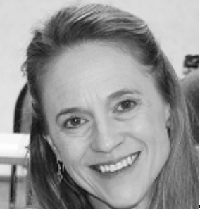
JENNIFER LEOIKI-DRINO
Mother of two children, one with learning differences
Parent Advocate and Coach
Private School Representative for SY 2021-2022 with SEAC
(Special Education Advisory Council)
HIDA Board Member and Public Awareness Committee Chair

Slide 7
IDEA – Individuals with Disabilities Act
U.S. education law passed by Congress in 1975 & reauthorized in 1990
Guarantees a Free Appropriate Public Education (FAPE) to eligible children with disabilities throughout the United States of America
Also ensures special education & related services for these eligible children
Notes:
Only 50 years ago, Students with LD guaranteed education. Before: Annie Sullivan/Helen Keller, separate schools for all students with disabilities. IDEA: public schools FAPE, ADA: all students with disabilities protected and are entitled to reasonable accommodations

Slide 8
Section 504 of the Rehabilitation Act
Civil Rights Law prohibiting discrimination on the basis of a disability in programs that receive federal funding
Schools develop formal 504 plans to provide kids with disabilities – including learning differences such as dyslexia –
the support they need to protect their rights in school
Notes:
504: public schools, accommodations

Slide 9
Americans with Disabilities Act (ADA)
Civil Rights Law prohibiting discrimination on the basis of a disability in employment, public services & accommodations
Children with learning differences – such as dyslexia – are protected from discrimination by this law in school & elsewhere (e.g., public places such as parks, restaurants & other businesses)
Notes:
ADA: all students with disabilities protected and are entitled to reasonable accommodations

Slide 11
Understand Your Child’s Way of Learning
Get past your initial fears & denial.
Learn all you can about dyslexia
Be able to explain how dyslexia impacts your child
Become thoroughly familiar with assessments of your child’s learning
Know the strategies that help your child succeed
Understand which accommodations bypass your child’s challenges
Be attuned to your child’s experiences.
Reflect on both your child’s successes & limitations.

Slide 12
Practice Communicating
Learn how to make clear requests & back them up with explanations.
Role-playing different situations & putting together the needed information in advance helps to build confidence
Your manner of communication can create allies or it can leave others confused or defensive.

Slide 13
Identify Supporters
You need to know people:
Whom you can trust
With whom you can comfortably share experiences
From whom you can seek advice
These supporters are a
crucial life-long resource for you.

Slide 14
Meet with Teachers and Counselors
Opportunity for you to:
Get useful feedback
Provide your own perspective
Hear the reasoning behind the recommendations of others
Participate in creating your child’s IEP, 504 or other personal education plan
You can model how to advocate to help your child to develop their own self-advocacy skills.

Slide 15
SELF-ADVOCACY CARD
» Download card at HIDA website: hi.dyslexiaida.org
» Print card and fill in
» Give card to your teacher

Slide 16
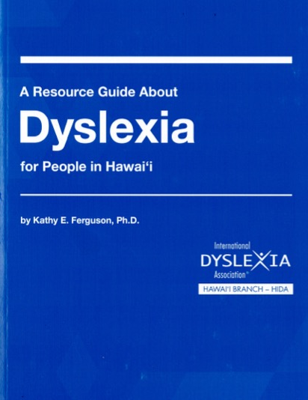
Educate Others
Many people will be uninformed or misinformed about dyslexia.
Peers may be curious
Teachers may be unprepared
Employers may be hesitant
Each conversation will hone your advocacy skills & perhaps improve the situation for the next
parent of a child with dyslexia.

Slide 17
Keep Thinking
As your child’s life circumstances change, their challenges & satisfactions will also evolve.
Reflect on both positive & negative experiences, looking for concrete methods of improvement
Self-evaluation is often you & your child’s
greatest source of insight.

Slide 18
Email INFO.HI@DYSLEXIAIDA.ORG
for a **free** silicone wristband for a student with dyslexia or other learning difference who is in need of some encouragement and inspiration
Mahalo to IDA Oregon Branch for the opportunity to join in sharing the self-advocacy card + wristband with students!

Slide 19
Keep Informed: HIDANews
https://hi.dyslexiaida.org/news/
Your Support Changes Lives
https://hi.dyslexiaida.org/donate/donate/

Slide 20
Notes:
See HIDAʻs table for more information

Slide 21
HI.DyslexiaIDA.org
info.HI@DyslexiaIDA.org
(808) 538-7007
@hawaiidyslexia
“Hawaii Dyslexia – HIDA YouTube”

